Slide 1




A PROPOSED CHURCH MEMBER EVENT TRACKING SYSTEM FOR TOUCHING HEART CHRISTIAN ASSEMBLY CHURCH CALOOCAN
Presented by Justin Paul T. Go

Slide 2
INTRODUCTION
As the Touching Heart Christian Church family grows, it faces a common challenge in managing member information. The main issue is our current manual process for recording attendance, which relies on pen and paper or scattered computer files. This approach can make records feel disorganized and hard to find, making it difficult to see who is actively participating in our community events.

Slide 3


Slide 4
INTRODUCTION
This project aims to address the current challenges in manual record-keeping at Touching Heart Christian Church. The core objective is to develop a centralized system for the effective creation, management, and tracking of member information and event attendance.

Slide 5

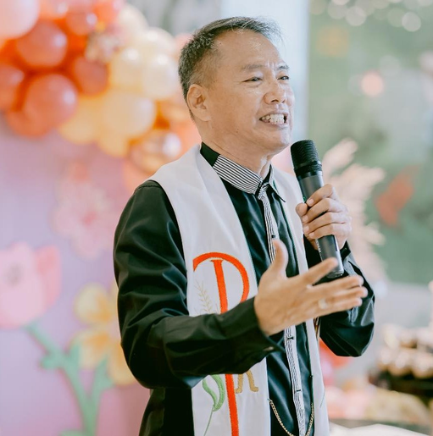
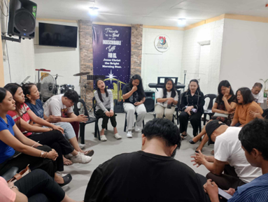
CLIENT INFORMATION
Client Profile: Touching Heart Christian Assembly
Location: Block 9, Lot 36, Barangay 35, Caloocan City
Contact Person: Bishop Alex

Slide 6
PROJECT SCOPE
This project aims to build a simple and secure church management system that helps leaders record attendance and manage member profiles. The primary goal is to track event participation to achieve more organized and efficient church operations.

Slide 7
INCLUSION
The system will store and organize basic member information such as names and contact details. It will allow leaders to manually record attendance during events and generate an on-screen digital ID. All data will be arranged for easy review and will always be accessible offline, without needing an internet connection.

Slide 8
EXCLUSIONS
This system will not provide individual login access for general members, as it is designed for leaders only. It does not support automated input like QR code scanning for attendance and will not send any SMS or email reminders. The system is also strictly for desktop or laptop use and will not be available on mobile devices.

Slide 9
ASSUMPTIONS AND CONSTRAINTS
-We assume that church leaders will be guided on how to use the system and that all data will be entered manually by authorized users. The church is also expected to have a dedicated desktop or laptop that meets the system’s minimum requirements.
-The system is constrained to run only on a desktop or laptop and cannot be accessed remotely. For security purposes, access is restricted to authorized leaders, as it does not support multiple user roles.

Slide 10
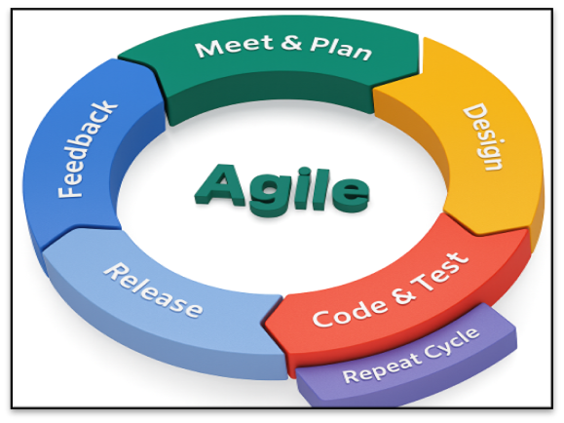
AGILE
Our process works in a continuous cycle. We will meet and plan, design the features, code and test them, and then release a working part of the system for you to use. After gathering your feedback, we will repeat the cycle, making improvements with each iteration.

Slide 11

SYSTEM DESIGN

Slide 12
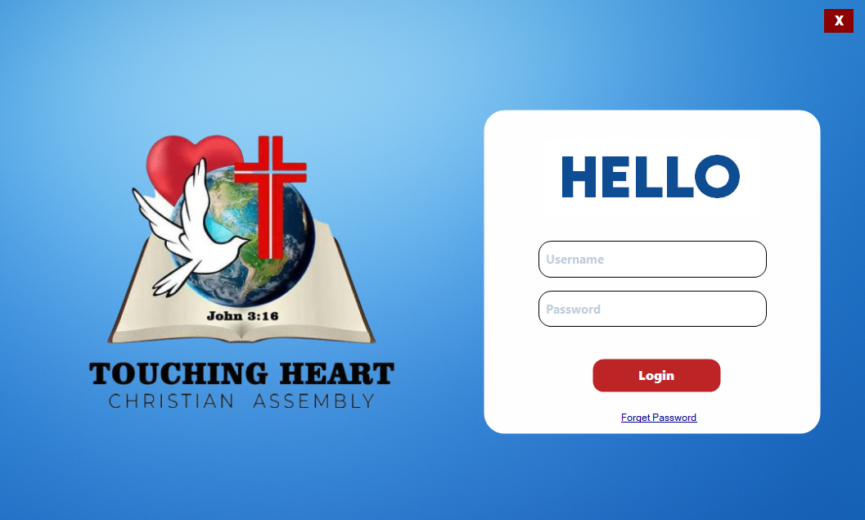

Slide 13
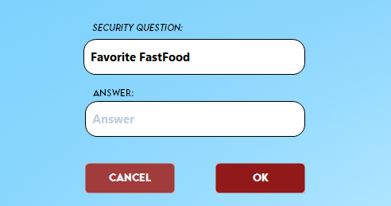

Slide 14
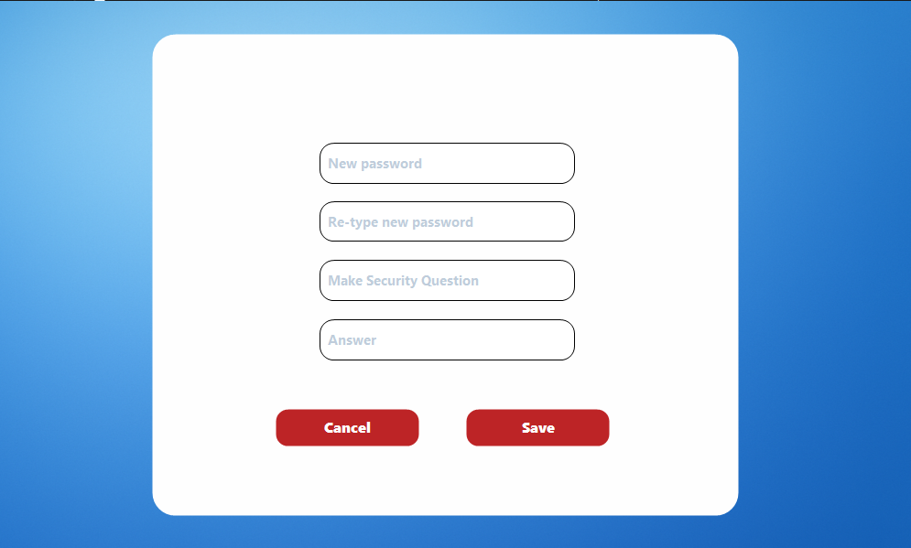

Slide 15
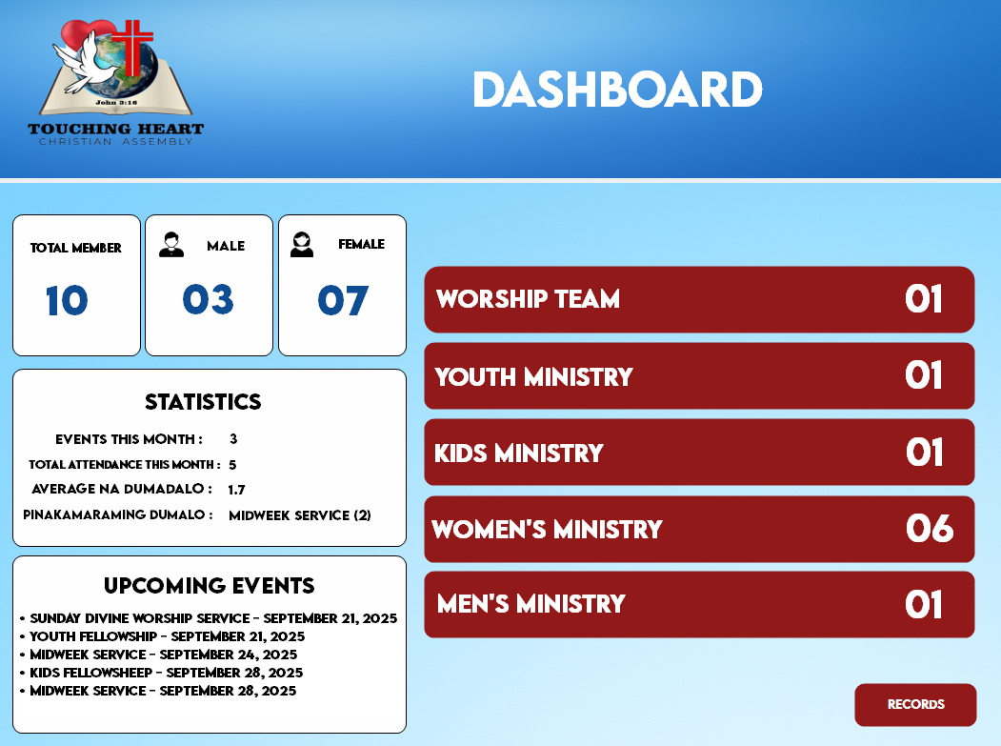

Slide 16
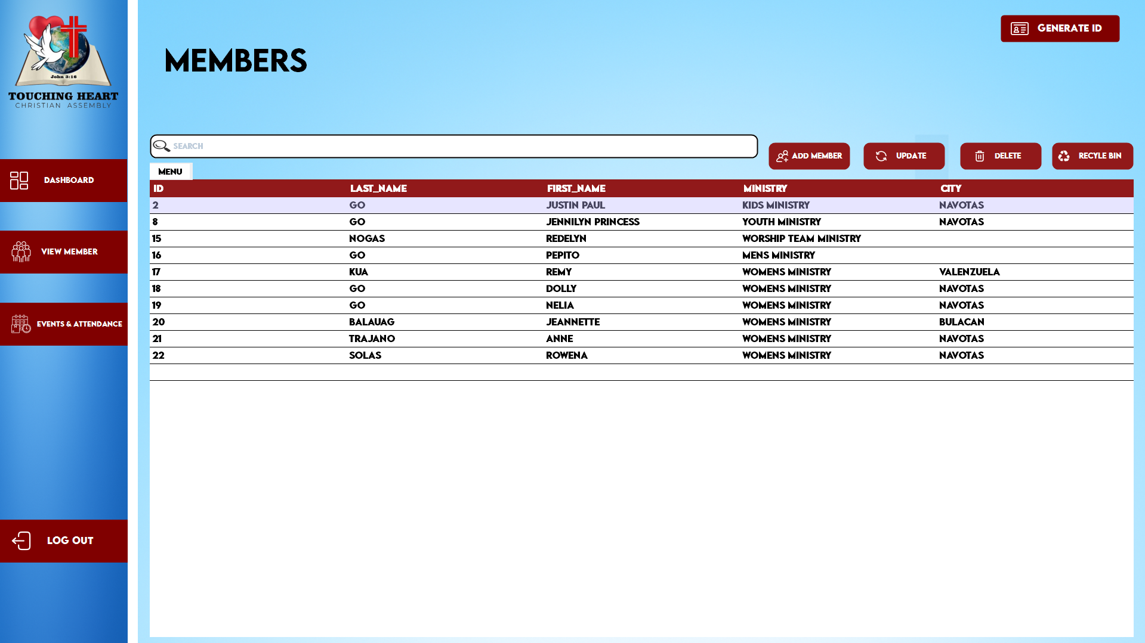

Slide 17
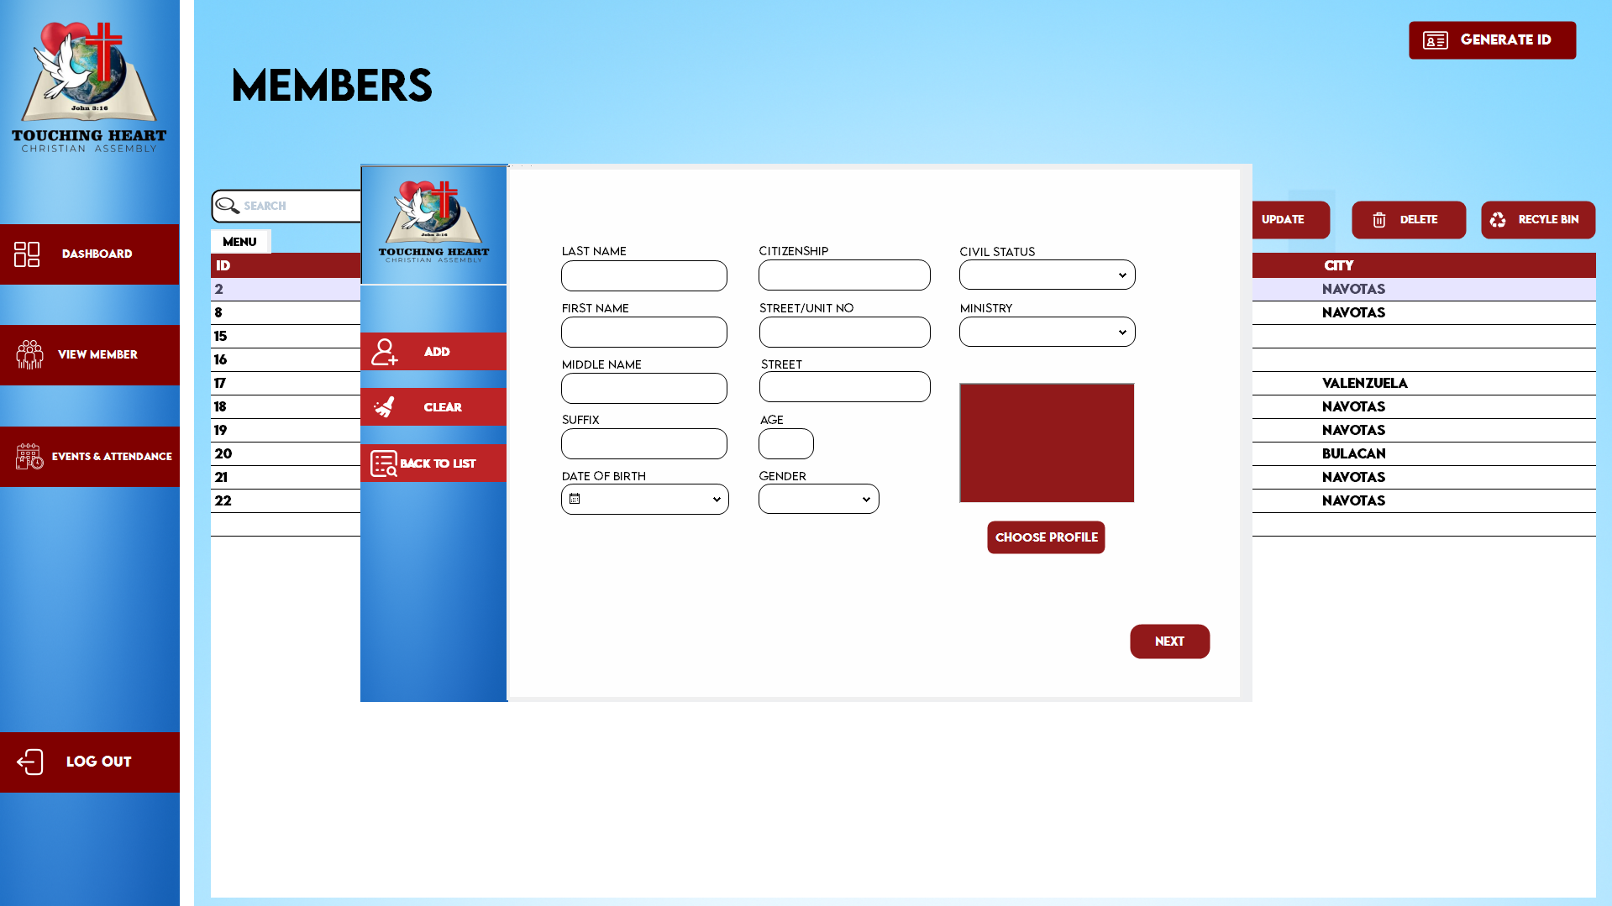

Slide 18
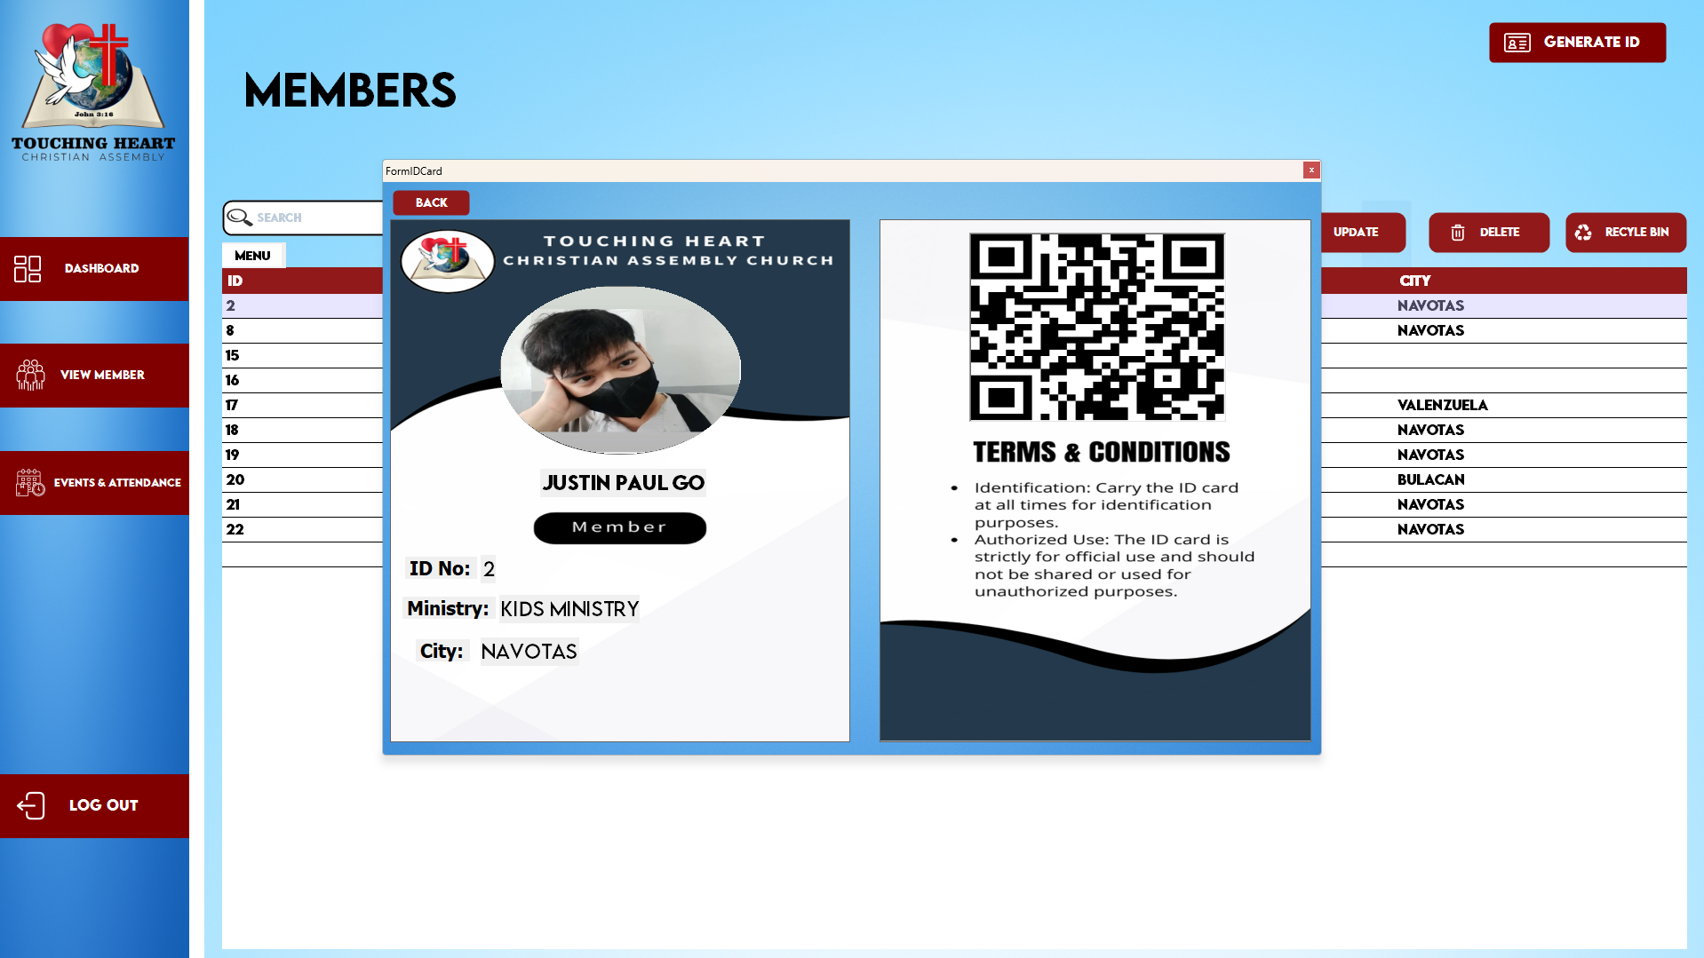

Slide 19
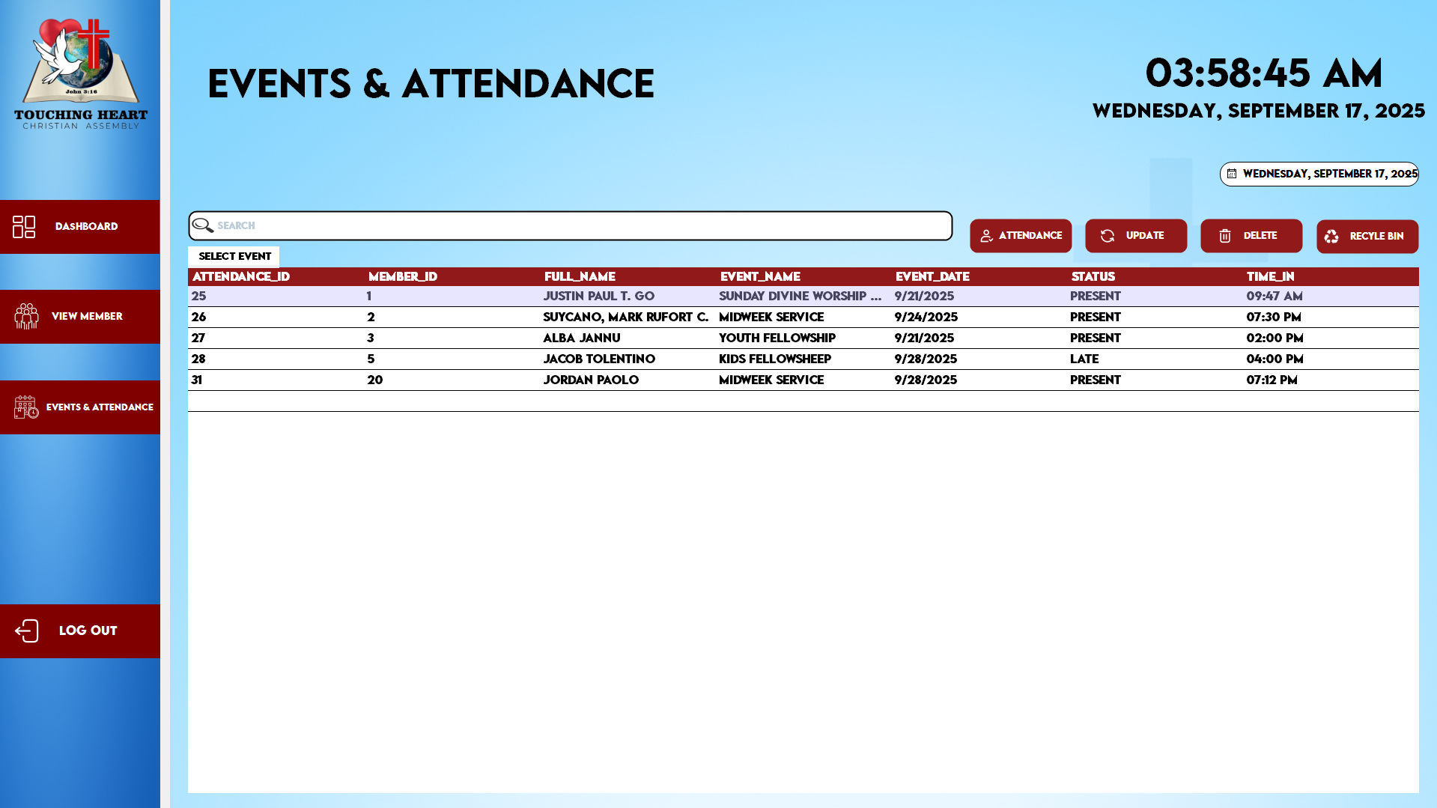

Slide 20
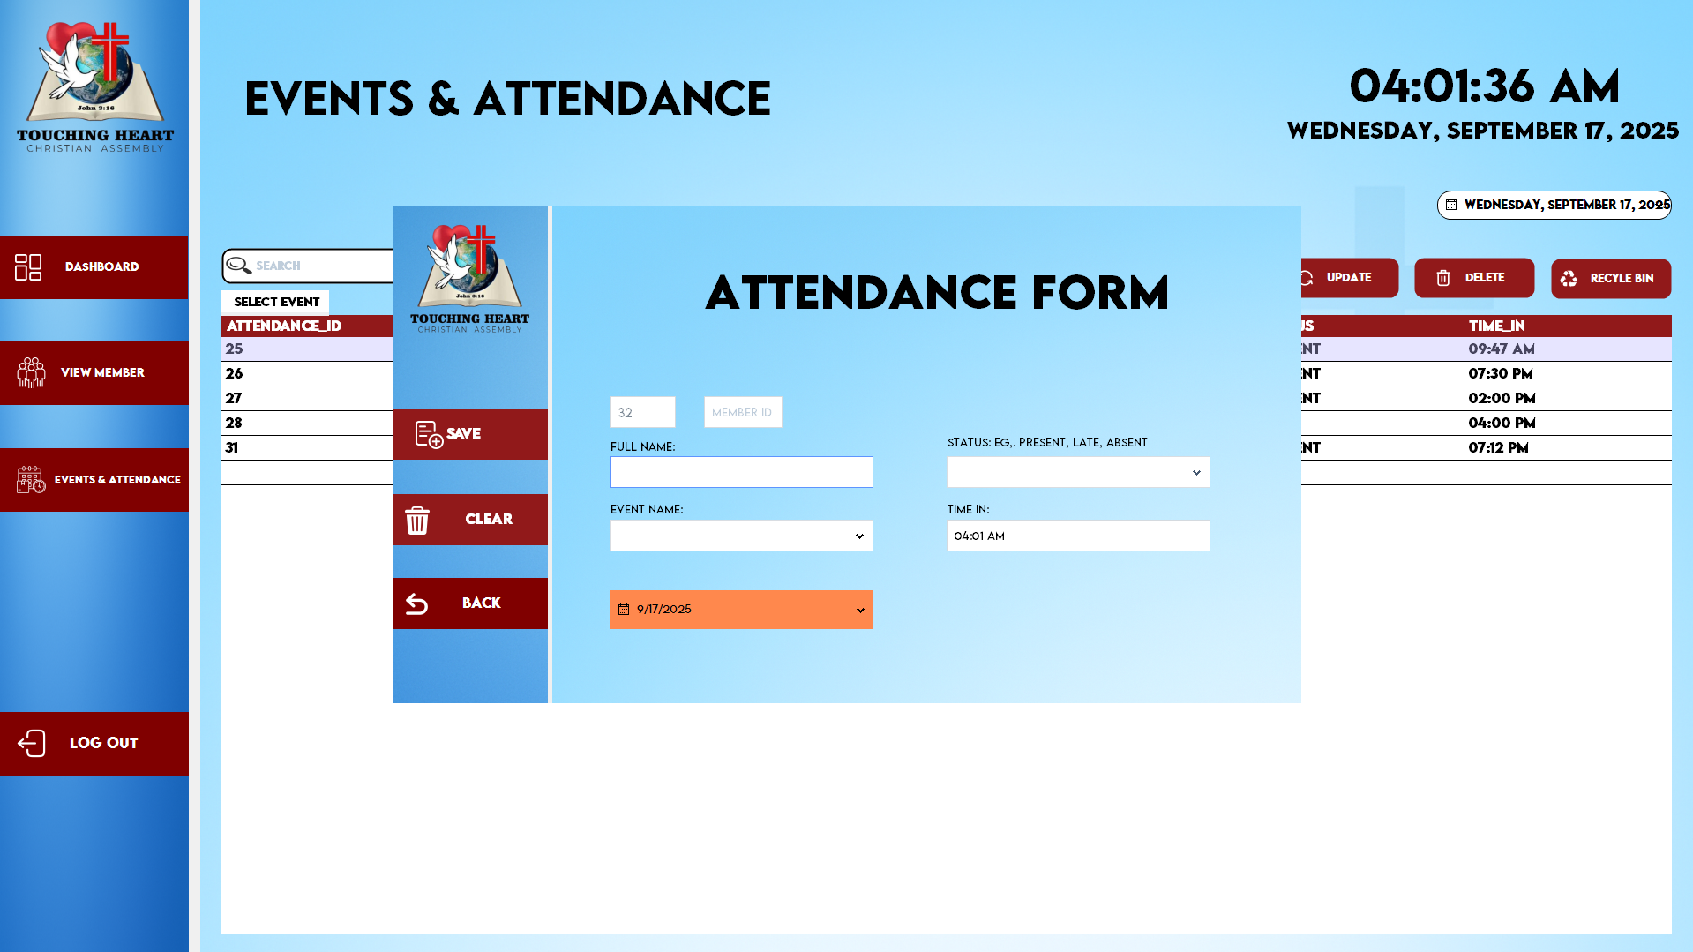

Slide 21
